Slide 1

Using Alexnet to sort stores
By Alec Jean Jacques
MAP 2192

Slide 2

Applications
Improved shopping experience: Shoppers can avoid long lines and crowded spaces, leading to a more relaxed and enjoyable shopping experience.
Improved store operations: By monitoring store traffic, retailers can optimize their store layouts, staffing levels, and inventory management.
Real-time store monitoring: Retailers can use sensors to monitor the number of shoppers in each store.
Notes:
Improved shopping exp-On the other hand, identifying the most crowded stores can help shoppers plan their shopping trips, avoid peak times, and minimize wait times.

Slide 3

What is Alexnet?
AlexNet is a convolutional neural network (CNN) architecture designed for image classification tasks.
The architecture of AlexNet consists of eight layers:
Five convolutional layers,
Three fully connected layers.
Additionally, it incorporates some crucial technological advances like rectified linear units (ReLU) functions and pooling layers.

Slide 4
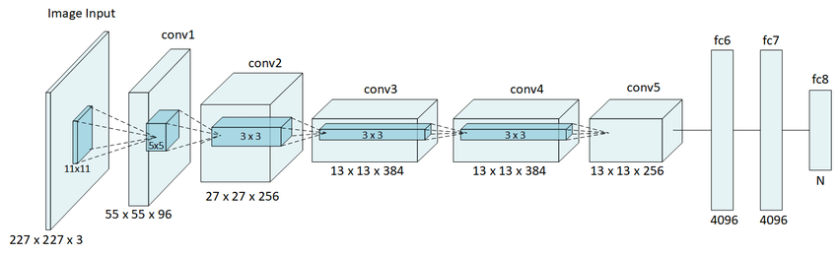


Slide 5
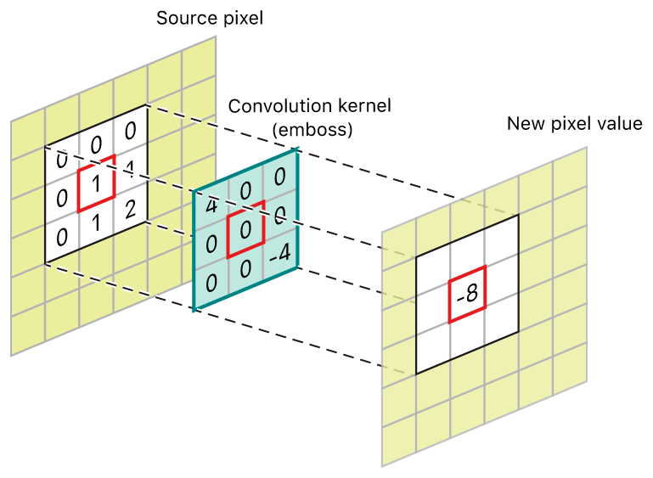

Image convolution
Image convolution is a mathematical operation that involves applying a small matrix, called a kernel or a filter, to an image to produce a new image.
Notes:
The process involves sliding the kernel over each pixel in the input image, performing a dot product between the kernel and the corresponding pixels in the image, and then assigning the result to the corresponding pixel in the output image.

Slide 6
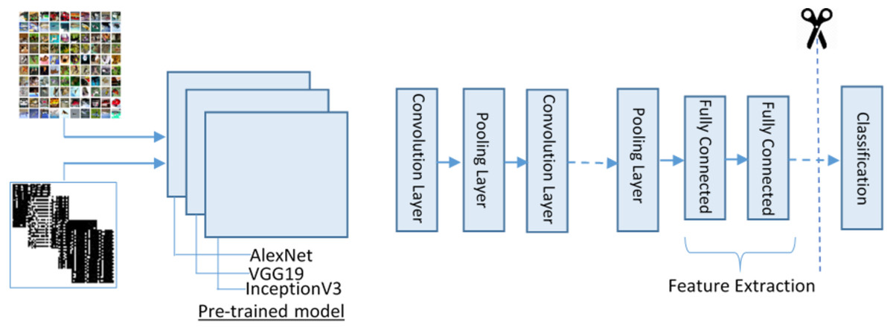

Feature Extraction
Feature extraction is the process of extracting relevant features or patterns from raw.
Notes:
Presents data in a meaningful and informative way.

Slide 7
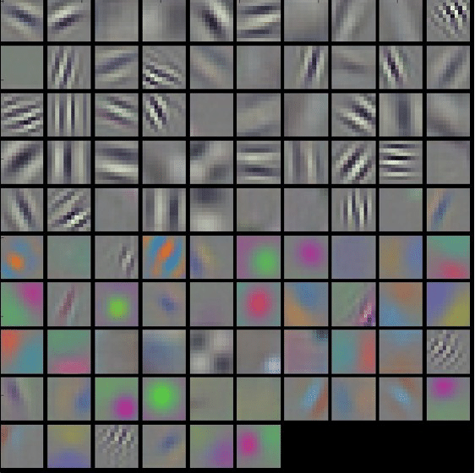

Alexnet filter
The AlexNet filter (also known as a kernel) is a small matrix of weights that is used to perform convolution operations on the input image.
Notes:
Each filter is applied to a small local region of the input image, and the result of the convolution operation is a new image that highlights the presence of the feature that the filter is designed to detect.
The output of each convolutional layer is passed through a rectified linear unit (ReLU) activation function.
ReLu introduces nonlinearity into the model and helps to improve its performance.

Slide 8



Image Classification
Image classification is a computer vision task that involves assigning a label or category to an input image based on its visual content.

Slide 9
